Slide 1
Rockbuster Stealth LLC
Online Video Service

Slide 2
Back Ground
Objective
Key Questions
Rockbuster Stealth LLC is a movie rental company that used to have stores around the world. Facing stiff competition from streaming services such as Netflix and Amazon Prime.
The Rockbuster Stealth management team is planning to use its existing movie licenses to launch an online video rental service in order to stay competitive.
● Which movies contributed the most/least to revenue gain?
● What was the average rental duration for all videos?
● Which countries are Rockbuster customers based in?
● Where are customers with a high lifetime value based?
● Do sales figures vary between geographic regions?

Slide 3
Movies with Most Revenue
Movies with Least Revenue
S. No | Movie-title | total_revenue in $
1 | Telegraph Voyage | 215.75
2 | Zorro Ark | 199.72
3 | Wife Turn | 198.73
4 | Innocent Usual | 191.74
5 | Hustler Party | 190.78
S.No | title | total_revenue in $
1 | Oklahoma Jumanji | 5.94
2 | Duffel Apocalypse | 5.94
3 | Texas Watch | 5.94
4 | Freedom Cleopatra | 5.95
5 | Rebel Airport | 6.93

Slide 4
Total Film Titles
Countries and cities
Average Revenue per Rental
1000
599
109
5 days
2.98$
Total Customers
Average Rental Duration

Slide 5
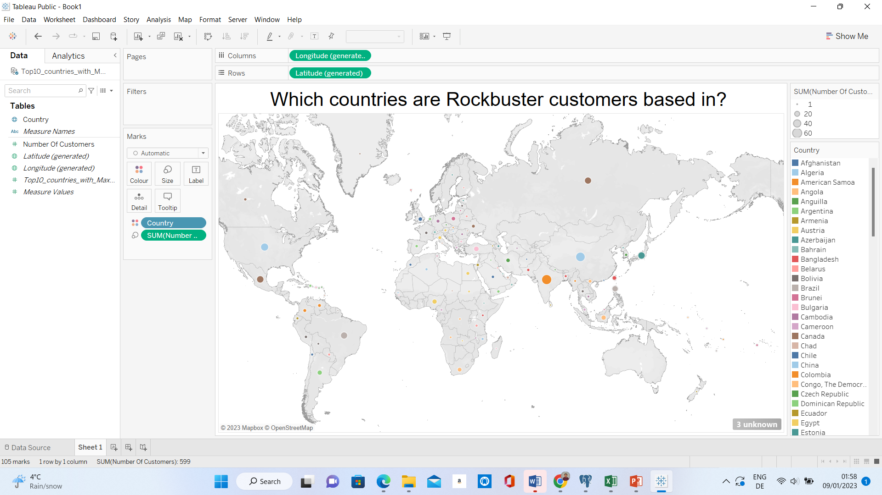
Tableau Link: Which_countries_Rockbuster | Tableau Public

Slide 6
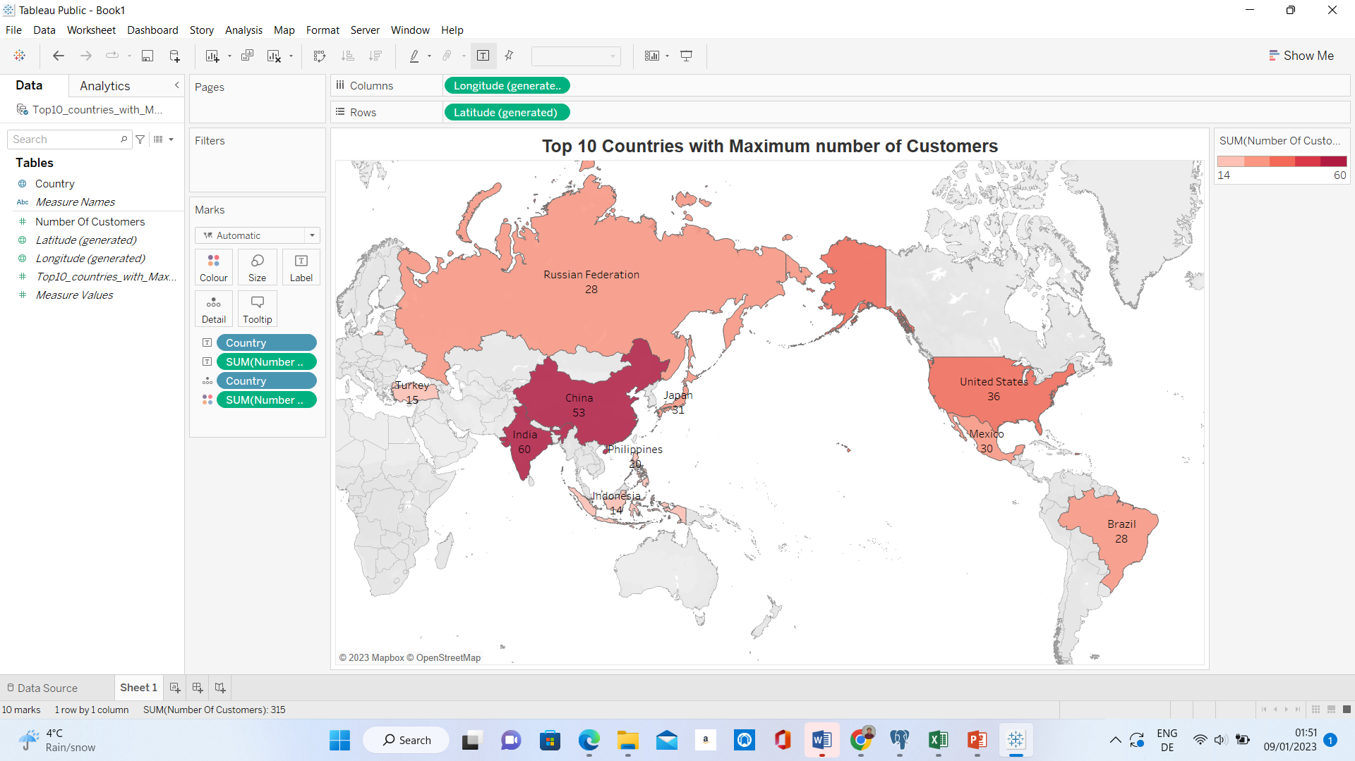
Tableau Link: Top10-Countries-Max-Customers | Tableau Public

Slide 7
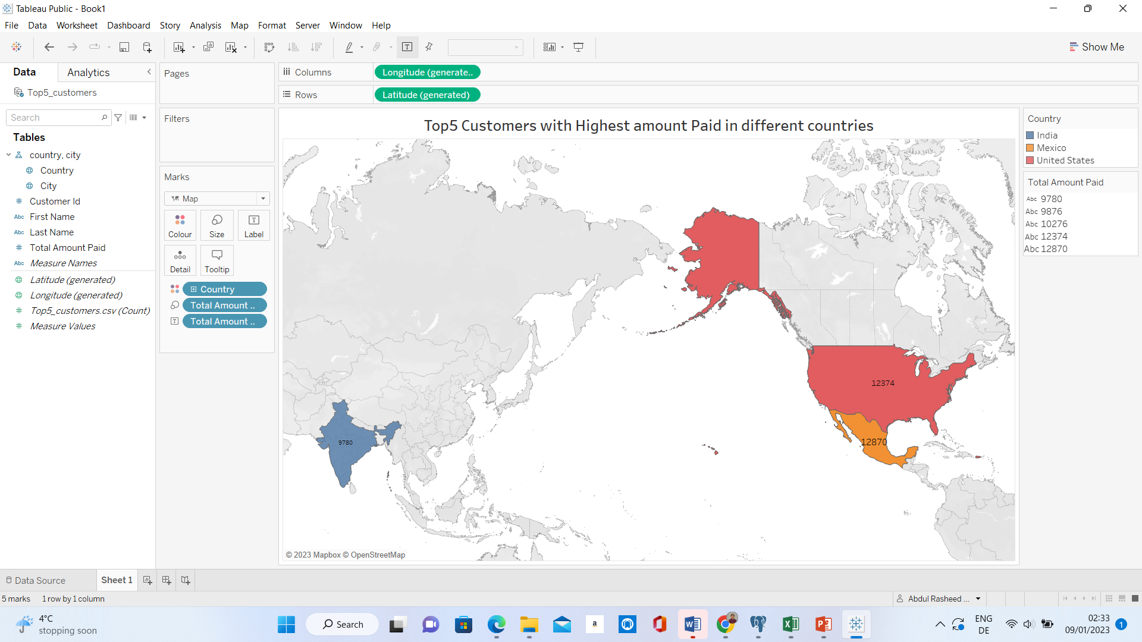
Tableau Link:Top5_Customers_Higest_paid | Tableau Public

Slide 8
Where are customers with a high lifetime value based
customer_id | first_name | last_name | city | country | total_amount_paid in $
84 | Sara | Perry | Atlixco | Mexico | 128.70
2 | Patricia | Johnson | San Bernardino | United States | 123.74
587 | Sergio | Stanfield | Celaya | Mexico | 102.76
537 | Clinton | Buford | Aurora | United States | 98.76
367 | Adam | Gooch | Adoni | India | 97.80

Slide 9
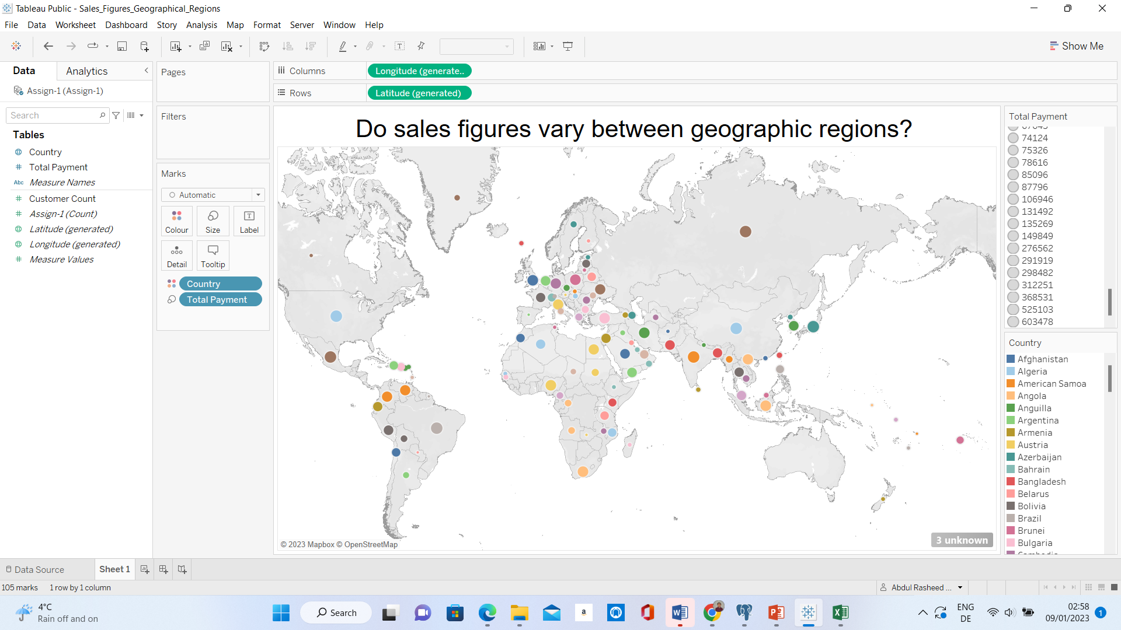
Tableau Link:Sales_Figures_Geographical_Regions | Tableau Public

Slide 10
Top10 Sales Figures in different Geographical Regions
S.No | country | customer_count | total_payment in $
1 | India | 60 | 6034.78
2 | China | 53 | 5251.03
3 | United States | 36 | 3685.31
4 | Japan | 31 | 3122.51
5 | Mexico | 30 | 2984.82
6 | Brazil | 28 | 2919.19
7 | Russian Federation | 28 | 2765.62
8 | Philippines | 20 | 2219.7
9 | Turkey | 15 | 1498.49
10 | Indonesia | 14 | 1352.69

Slide 11
Recommendations
Rockbuster has customers all around the world. This is the advantage for the online platform as the company’s name is already known in all these markets.
Create the Online platform and use Latest technologies to compete in Market.
Highest Revenue is coming from India, So invest more in india to get more subscriptions as India population is more.
Average Rental per title is 2.98$, which is very competitive. If you increase little more dollars and provide all the titles as subscription basis. Then the customers and also revenue will increase.
Increase the marketing budget in the weak markets.

Slide 12
Questions?
Email:abdulrasheedj@gmail.com

